Slide 1

THE BEST
ENGLISH
LEARNER

Slide 2
ANIMALS
1
2
3
4
5
FOOD
1
2
3
4
5
HOUSE
1
2
3
4
5
ACTIVITIES
1
2
3
4
5
SCHOOL
1
2
3
4
5

Slide 3
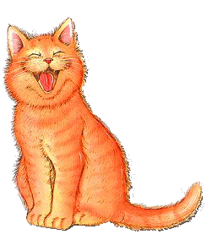



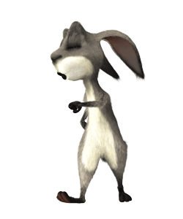



Name the animals:
cat
dog
tiger
mouse
lizard
lion
rabbit
elephant

Slide 4

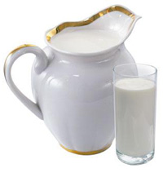
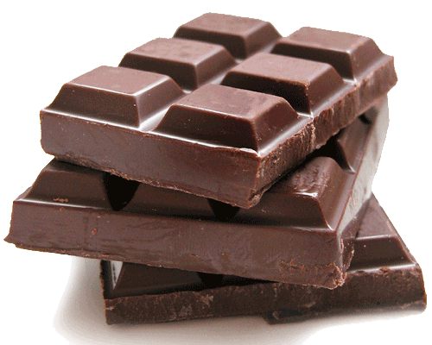

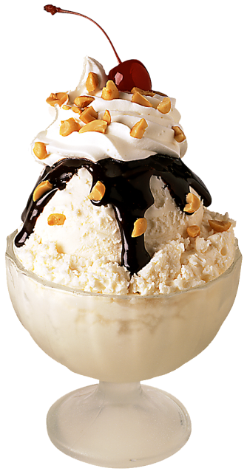


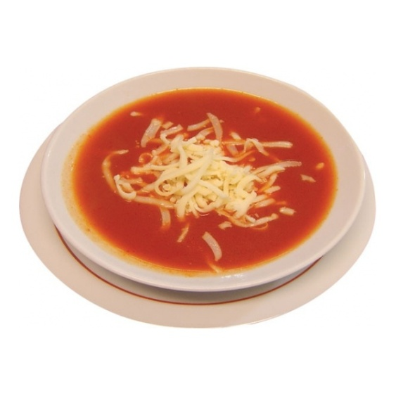
Name these kinds of food:
Cheese
Bananas
Milk
Chocolate
Oranges
Cake
Ice-cream
Soup

Slide 5
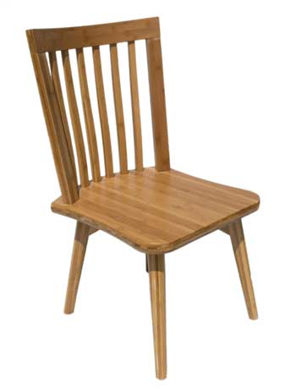
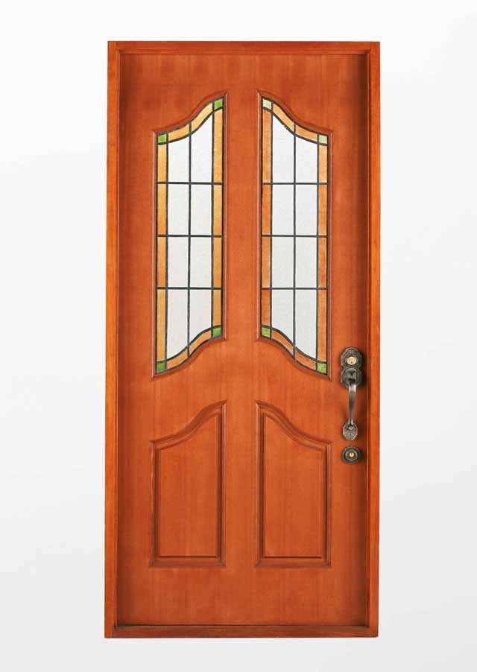


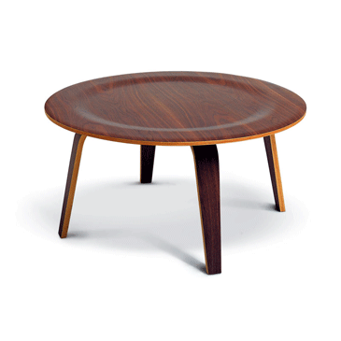
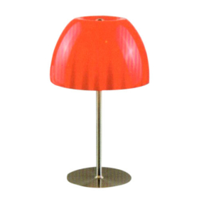

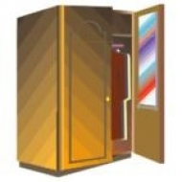
Name the objects:
chair
TV-set
door
bed
lamp
table
cupboard
computer

Slide 6




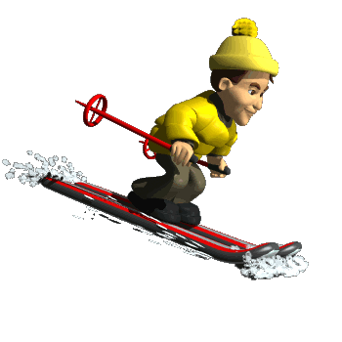



Name the actions:
Dancing
Jumping
Reading
Skipping
Skiing
Swimming
Playing football
Skating

Slide 7
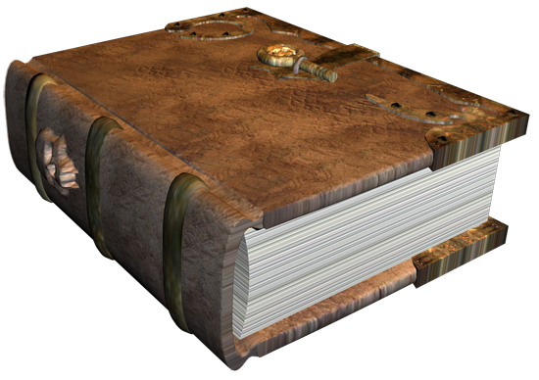

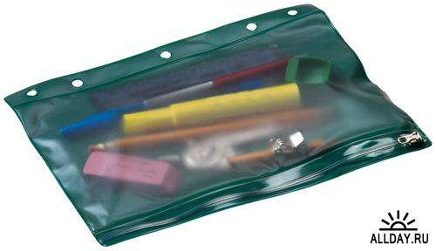

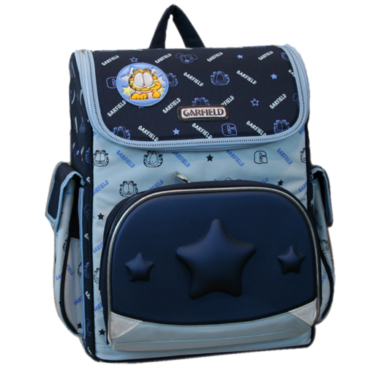



Name the objects
ruler
pencil case
book
exercise book
pen
School bag
rubber
pencil

Slide 8
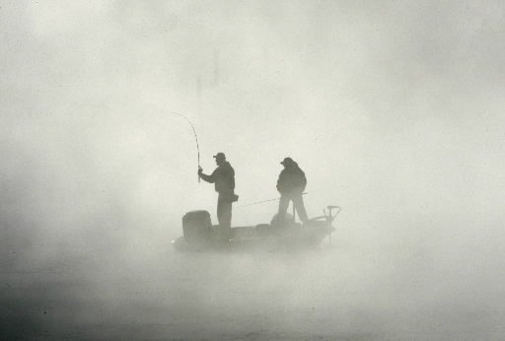
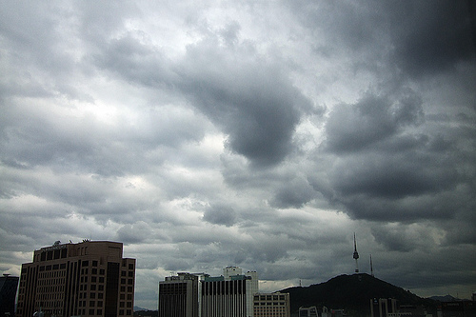




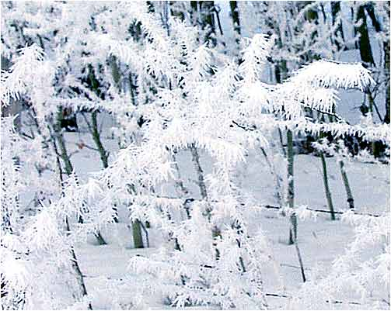

Give the adjectives describing pictures:
Hot
Foggy
Cloudy
Rainy
Cold
Sunny
Windy
Snowy

Slide 9
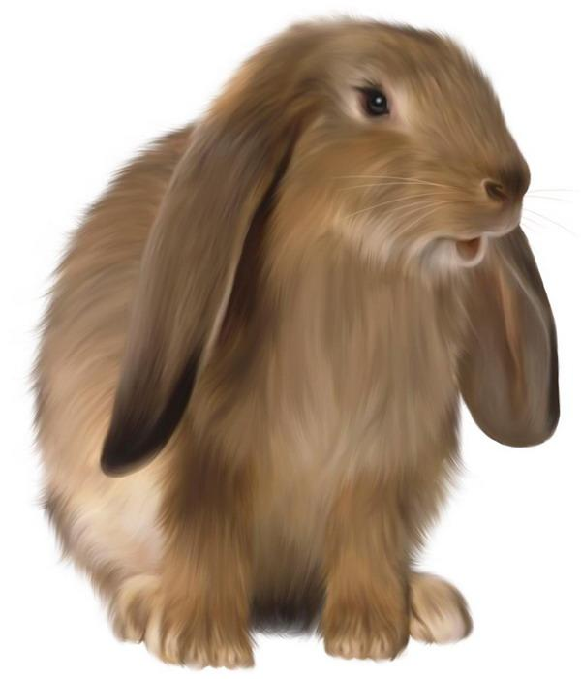
Name domestic and wild animals:
cats
tigers
dogs
wolves
hens
cows
pigs
monkeys
lions
deer
ducks
rabbits
giraffes
sheep
Wild
Domestic

Slide 10

Name fruits and vegetables:
corn
tomatoes
oranges
apples
cabbage
lemons
carrots
potatoes
bananas
grapes
cucumbers
peaches
pears
plums
Fruits
Vegetables

Slide 11
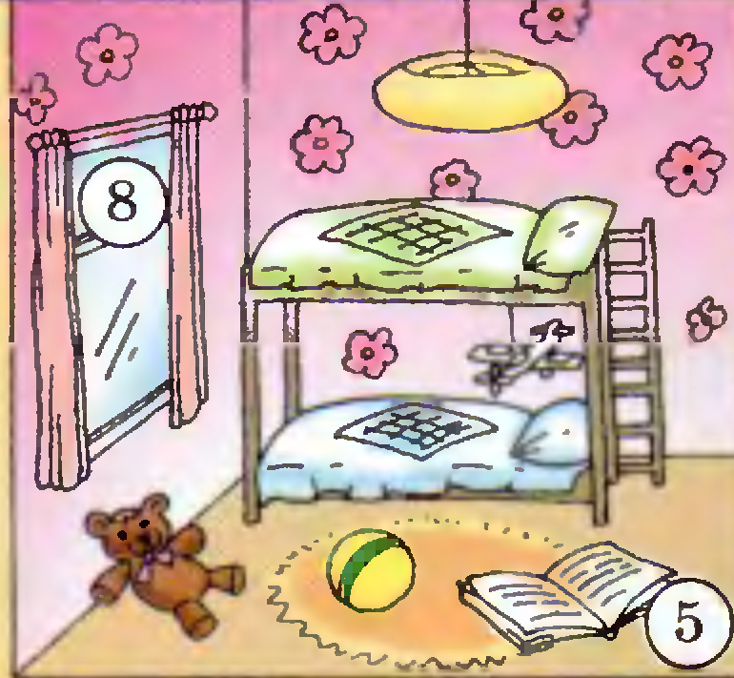
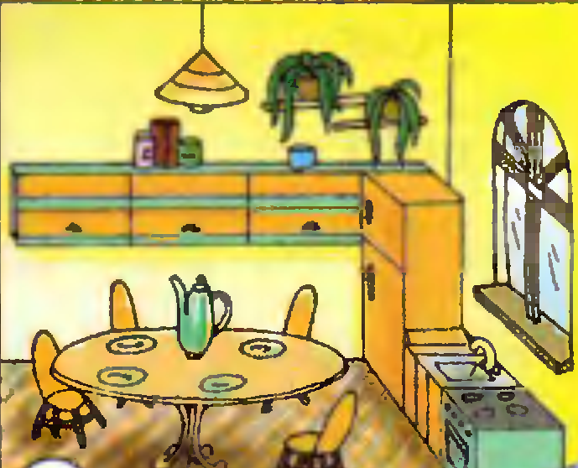
Name objects from the bedroom and the kitchen:
A bed
A fridge
A table
A desk
A computer
A bookshelf
A wardrobe
A cupboard
A sink
A table lamp
Books
A teapot
Cups
A stove
Kitchen
Bedroom

Slide 12
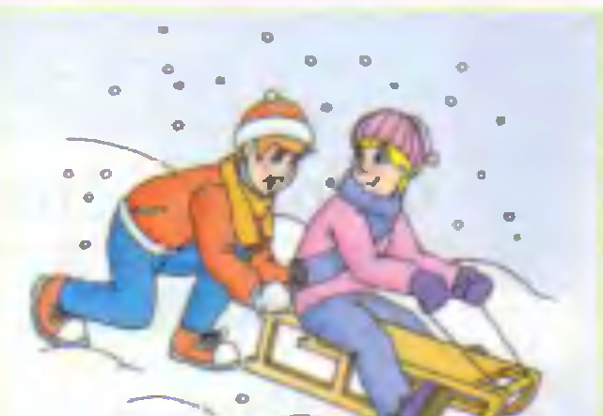
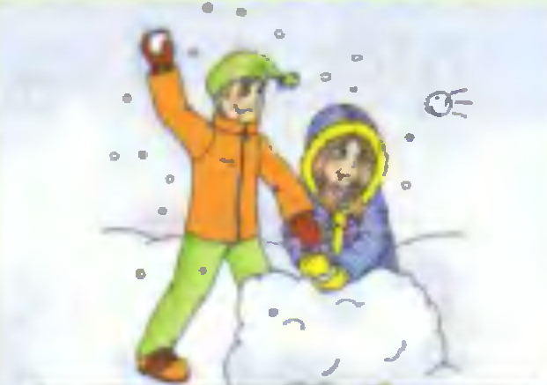
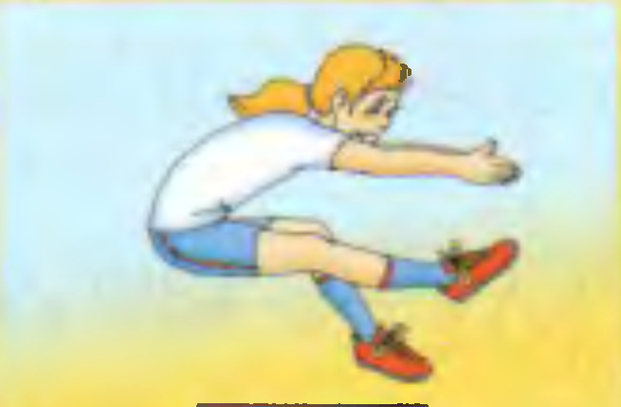
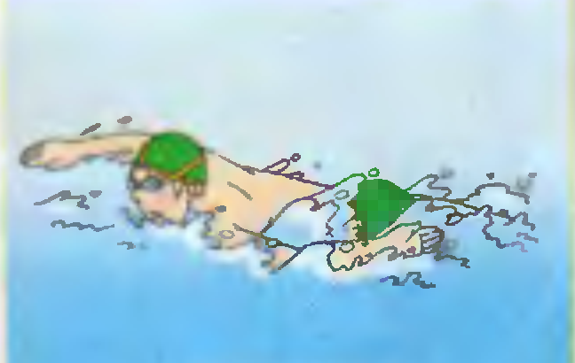
Name winter and summer activities:
Skiing
Swimming
Tobogganing
Playing volleyball
Diving
Playing snowballs
Playing football
Skating
Jumping
Making a snowman
Playing tennis
Walking
Riding a bike
Winter activities
Summer activities

Slide 13

Match subject and action
Nature Study
Art
Maths
Music
English
PE
Crafts
run
Play and do projects
sing
read
do sums
draw
make cards

Slide 14
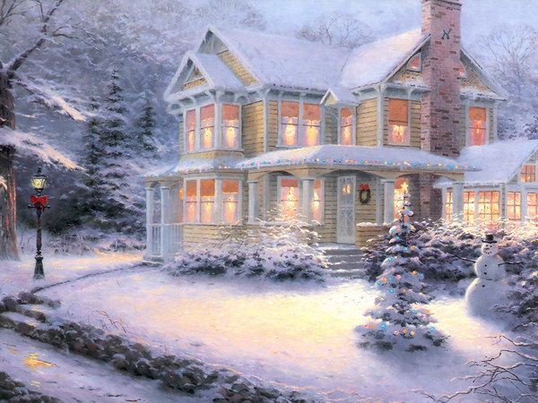
Choose the adjectives which can describe both – summer and winter weather:
Sunny
Warm
Rainy
Foggy
Windy
Frosty
Snowy
Hot
Cloudy
Cold
Adjectives

Slide 15
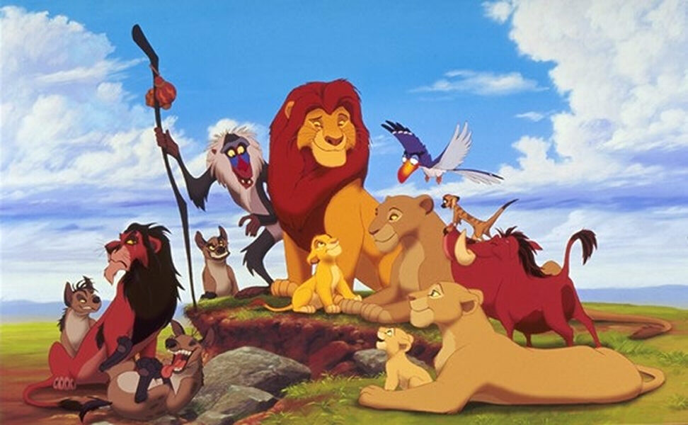
Name a missing word in a couple:
ONE | MANY | ONE | MANY
A cat | Cats | A sheep | Sheep
A fox | Foxes | A horse | Horses
A wolf | Wolves | A deer | Deer
A fish | Fish | A pig | Pigs
A monkey | Monkeys | A mouse | Mice

Slide 16

Name a missing word in a couple (a, an, some):
some | cheese | a | tomato
a | banana | a | pear
an | apple | some | juice
an | orange | some | milk
some | soup | a | lemon
a | sweet | some | tea

Slide 17
Make up words:
lalh | hall | orod | door
citkneh | kitchen | amlp | lamp
ttolie | toilet | tfal | flat
diwnow | window | riahc | chair
uohse | house | ictupre | picture
oebormd | bedroom | tusdy | study

Slide 18

Use “play” where it is necessary:
play | tennis | - | skate
play | hockey | play | volleyball
- | jump | - | skip
play | snowballs | - | ski
- | swim | play | football
- | dance | - | dive

Slide 19
Name a missing word in a couple
Russian | English | Russian | English
вторник | Tuesday | расписание | timetable
суббота | Saturday | доска | board
понедельник | Monday | учитель | teacher
среда | Wednesday | ученик | pupil
пятница | Friday | окно | window

Slide 20
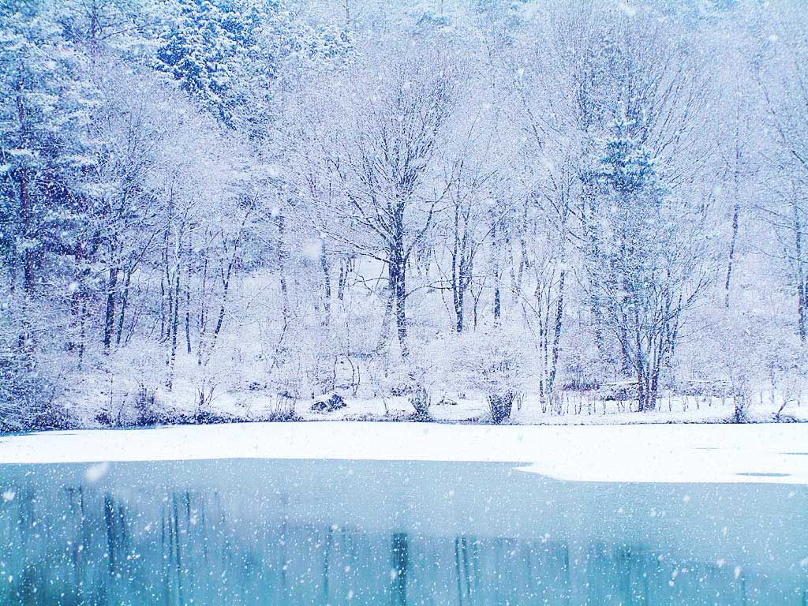
Name a season:
winter | January | spring | April
spring | March | autumn | October
autumn | September | autumn | November
summer | June | summer | July
summer | August | spring | May
winter | February | winter | December

Slide 21
Name a missing word in a couple (a, an, some):
some | cheese | a | tomato
a | banana | a | pear
an | apple | some | juice
an | orange | some | milk
some | soup | a | lemon
a | sweet | some | tea

Slide 22



Describe the animal you like:
He is… . He can… . He can’t … . He has got … . He lives … . He likes … .

Slide 23
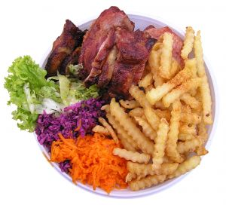
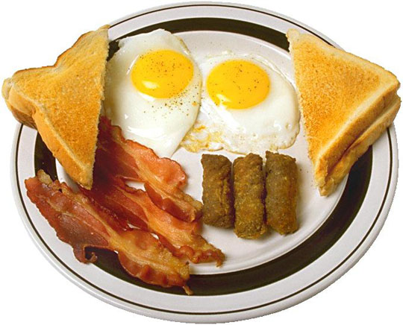
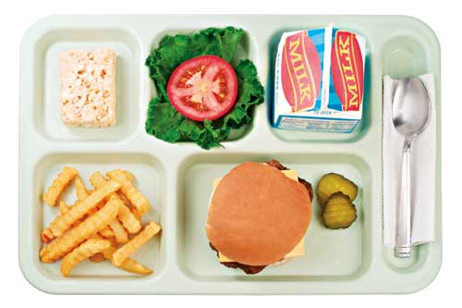
Say what you like for breakfast, lunch and dinner:
I like … for lunch.
I like … for breakfast.
I like … for dinner.

Slide 24
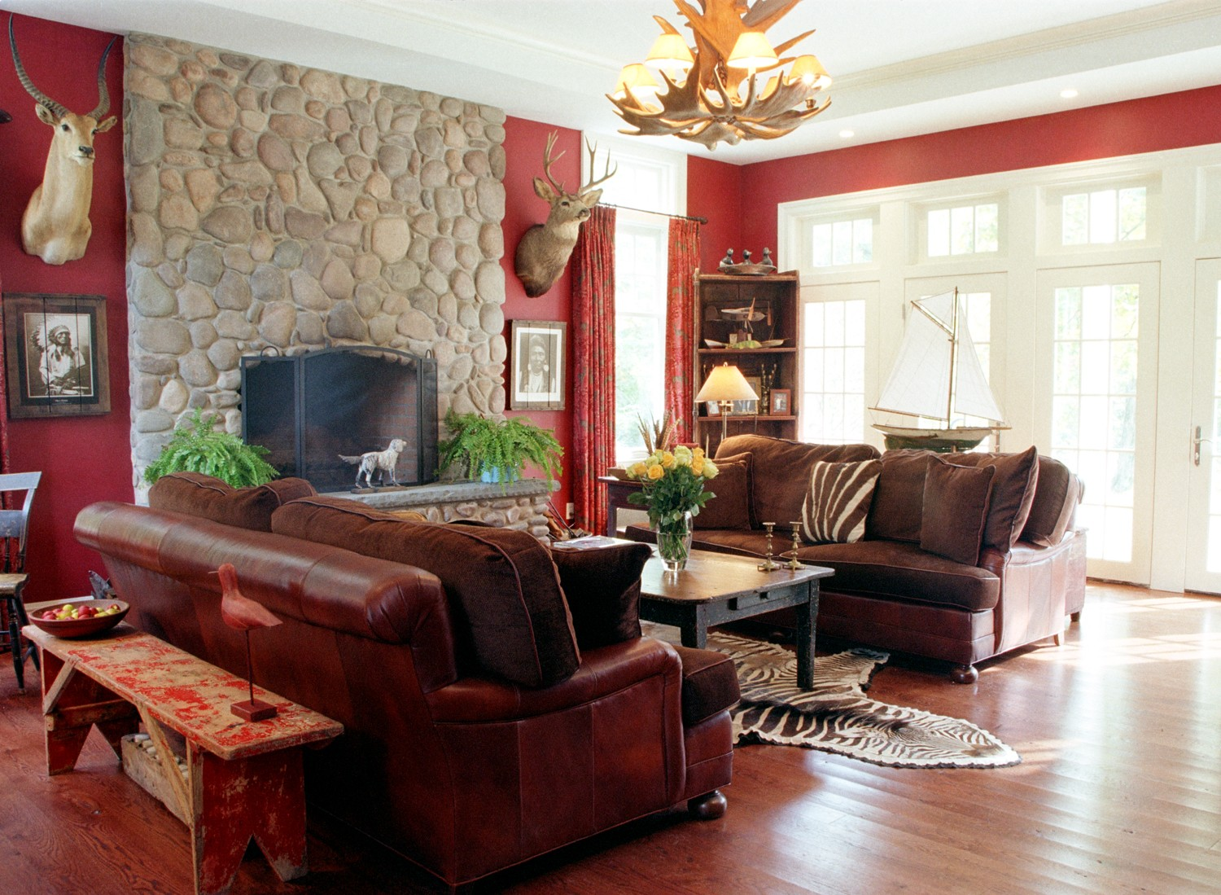
Describe the room:
The room is… .
There is … in the room.
There are … in the room.

Slide 25
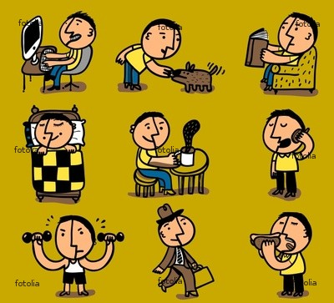
Say what you like to do and what you can do well:
I like to… .
I can … well.

Slide 26
Do the sums:
Eleven – eight =
three
Twelve + six =
eighteen
Two + thirteen =
fifteen
Nineteen – five =
fourteen
Seventeen – seven =
ten

Slide 27
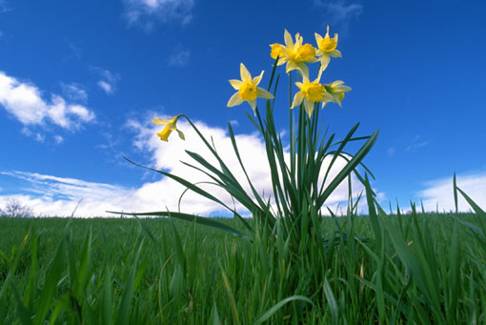
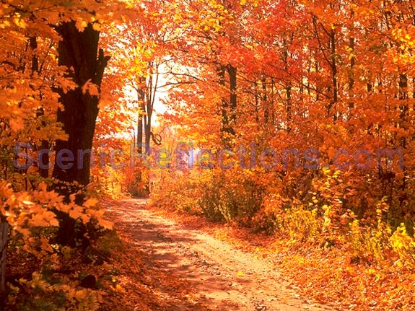
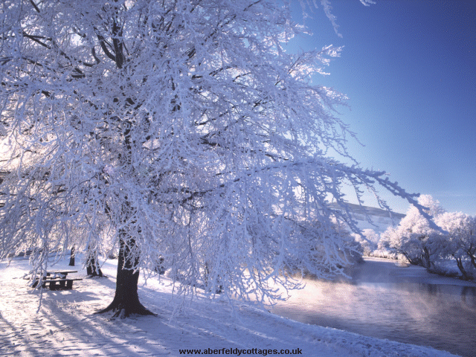

Describe your favourite season:
I like … because I can… .

Slide 28
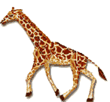
Read and guess what animal is described here:
It is a kind animal. It usually lives in Africa or in the zoo. It has got a lot of spots (пятна) and its neck is very long. It is big.
The answer
giraffe

Slide 29
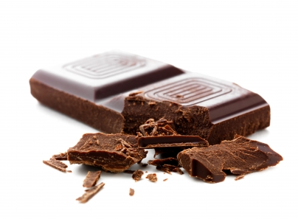
Read and guess what Jack likes to have for breakfast:
I like it very much. I usually have it for breakfast. It is brown but it can be white. It is tasty. Children like it.
The answer
chocolate

Slide 30
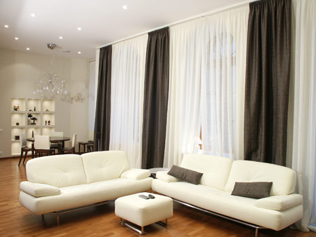
Read and guess what room is described:
People spend a lot of time in this room. There is a TV-set. There are armchairs, a carpet, a wardrobe.
The answer
Living room

Slide 31

Read and guess what activity is described:
People play it on the sports ground. You need a ball to play it. You throw it into the basket (корзина). It is a very interesting game.
The answer
basketball

Slide 32
Read and guess what subject is described:
Students usually play, read and sing in it. You can learn about countries in the world. It is in the classroom 26.
The answer
English

Slide 33

Read and guess what season is described:
People like this season because it is warm. We can swim in the river, ride a bike and run in the park. There are a lot of flowers.
The answer

Slide 34
Ссылки:
1. http://www.free-animations.co.uk/animals/cats/images/cat_92.gif
2. http://www.joblack59.com/HMS/us/2009-10/walker/animated-dog-3%5B1%5D.gif
3. http://www.central104.org/pages/uploaded_images/animated%20tiger.gif
4. http://mrsfickenscher.wikispaces.com/file/view/mice004.gif/113937395/mice004.gif
5. http://www.webweaver.nu/clipart/img/nature/elephants/circus-elephant.gif
6. http://www.spfdbus.com/halloween/H-kritters/redfoxscreenshot.gif
7. http://www.nonstopgifs.com/animated-gifs/cartoons/cartoons-animated-gif-005.gif
8. https://d44ytnim3cfy5.cloudfront.net/assets/3236944/original/rabbit.gif?1300689648
9. http://keju.org/500px-Cheese.svg.png
10. http://www.eda-server.ru/cooking-news/2009/03/img-03-09/09-03-03moloko.jpg
11. http://www.infovending.ru/wp-content/uploads/2010/05/Chocolate.png
12. http://us.cdn4.123rf.com/168nwm/all32/all321003/all32100300034/6673930-bunch-of-bananas-isolated-on-white-background.jpg
13. http://f3.foto.rambler.ru/preview/r/416x359/4b5036ba-aaa6-f267-6f6b-40ccc5c3671e/%D0%90%D0%BF%D0%B5%D0%BB%D1%8C%D1%81%D0%B8%D0%BD%D1%8B.jpg
14. http://www.pachd.com/free-images/food-images/candies-05.jpg
15. http://index-ok.ru/wp-content/uploads/2011/05/133.jpg
16. http://www.yemektarifiniz.net/upload/13634061520607187500domates_corbasi_359.jpg
17. http://www.executive-chair.org/wp-content/uploads/2011/05/Chair.jpg
18. http://www.konteaki-furniture.co.uk/images/chunky_pine_double_bed.jpg
19. http://www.lifeway.net.ru/novosti/tv-set.jpg
20. http://www.exoticindiaart.com/carpets/brown_colored_polycotton_carpet_kc26.jpg

Slide 35
21. http://www.italianclassicsdirect.co.uk/imagesstatic/big/occasionaltables/Eames%20Table.gif
22. http://pic.tradeage.com/modern-red-glass-table-lamp-97379.jpeg
23. http://www.find-electricalgoods.co.uk/productimages/109/LEC/L5026W.jpg
24. http://korzh.net/wp-content/uploads/2011/03/computer.jpg
25. http://paneliu-klubas.webs.com/strapless-satin-bubble-dress-cocktail-gown-prom.jpg
26. http://images03.olx.ru/ui/2/66/60/32976660_1.jpg
27.http://www.fashionconscience.com/media/catalog/product/cache/1/image/5e06319eda06f020e43594a9c230972d/f/i/fin_organic_cotton_trench_coat_black.jpg
28. http://dn.vtomske.ru/ona/article/226/maxi_short2.jpg
29. http://www.frenchtruckers.com/img/adidas-superstar-vintage-trainers.jpg
30. http://dressyshoes.net/wp-content/uploads/17-dressy-shoes.jpg
31. http://www.omiru.com/wp-content/uploads/2008/08/cashmere-crewnecksweater_082208.jpg
32. http://shop.1stclassclothes.biz/mm1CC/Images/trouser%206.jpg
33. http://www.gifs-paradise.com/animated_gifs/humans-dancing/animated-gifs-humans-dancing-63.gif
34. http://funforkids.ru/pictures/reading/reading07.png
35. http://gif-animation.leovacity.be/images/jumping-monkey-gif-animation.gif
36.http://th01.deviantart.net/fs71/150/i/2010/347/a/7/uni_animation__skipping_rope_by_duragan-d34shbj.png
37.http://publib.boulder.ibm.com/infocenter/iadthelp/v6r0/topic/com.ibm.etools.animgif.doc/images/skiing.gif
38. http://www.cksinfo.com/clipart/entertainment/skating/ice-skate-15.png
39.http://www.penclawddprimaryschool.ik.org/img/Animated_scuba_fish_swimming_hg_wht.gif
40. http://www.chevening.kent.sch.uk/images/soccer_player_animated.gif

Slide 36
41. http://dibellas.co.cc/i/p/1280753768.jpg
42. http://www.karachidigest.com/wp-content/uploads/2010/09/cloudy-weather.jpg
43. http://cookalasprettythings.files.wordpress.com/2011/05/rainy_weather_graphic_ap.jpg
44. http://icons.iconarchive.com/icons/custom-icon-design/weather/256/Sunny-icon.png
45. http://www.valdosta.edu/~jisoady/animated%20snow.gif
46. http://theawesomator.files.wordpress.com/2009/10/blowing-wind.gif?w=322&h=211
47. http://www.just-so-site.com/photos/1new/hoarfrost.jpg
48. http://www.spokesmanreview.com/media/photos/20071029_foggy.JPG
49. http://www.cherlaan.com/ekmps/shops/rhanley/resources/Design/web-sweets-mr-mrs-pink.jpg
50. http://lovelypackage.com/wp-content/uploads/2008/12/sweets1.jpg
51. http://www.learnenglish.de/IMAGES/Vocab/Buildings/Rooms.gif
52. http://noisypost.com/wp-content/uploads/2011/03/home12.jpg
53. http://www.webweaver.nu/clipart/img/entertainment/sports/hockey/hockey-snoopy.gif
54. http://basik.ru/images/winter_time_1/02_winter_time.jpg
55. http://www.fwallpaper.net/pics/cartoons/disney-winnie-the-pooh/disney-winnie-the-pooh_4.jpg
56. http://img1.liveinternet.ru/images/attach/c/2//65/791/65791547_disney_characters_pluto.jpg
57. http://img0.liveinternet.ru/images/attach/c/1//60/90/60090997_741DonaldDuckPosters.jpg
58. http://cinema-ma.ru/wp-content/uploads/91-mickey_mouse.jpg
59.http://4.bp.blogspot.com/_7JPk1Lb6eyk/S8Ncl3gL5CI/AAAAAAAAAZA/9IUc8XV2ux4/s1600/Breakfast.jpg
60. http://blogs.babble.com/strollerderby/files/2010/12/school-lunch.jpg
61. http://www.recipekey.com/images/browse_pictures/dinner-recipes.jpg
62. http://ignorantdesign.com/wp-content/uploads/2010/08/Colony-Road-Living-Room.jpg
63.http://t1.ftcdn.net/jpg/00/29/31/18/400_F_29311802_5Om2dbHVNjKXlGjg0hC5IWpYFZu65OI1.jpg
64. http://squak.net/wp-content/uploads/2007/10/school_uniform.jpg
65.http://t1.ftcdn.net/jpg/00/31/49/36/400_F_31493609_KqUsWfj6KDp3dL6PcUpr2X3TDQ6KqMd1.jpg
66. http://zhurnal.lib.ru/img/p/poedinkin_w_w/detskiesny/summer.jpg
67. http://www.aberfeldycottages.co.uk/Images/river-tay-winter.bmp
68.http://attachmentsblog.tut.by/44795/files/2010/10/60013colors_of_autumn_free_screensaver_desktop_screen_savers.jpeg
69. http://www.webweaver.nu/clipart/img/nature/animals/giraffe-walking.gif
70. http://freestyledesigns.net/wp-content/uploads/2011/05/chocolate-bar.jpg
71. http://domosel.ru/uploads/posts//1263287111_1.jpg
72. http://www.appleanimation.com/pops.gif
73. http://www.footbolka.ru/catalog/images/KissMe.jpg
74. http://west.kernhigh.org/guidance/basketball_player_dribbling_md_wht.gif

